Slide 1


INNOVATIVE ENHANCEMENT IN ONLINE DELIVERY SERVICE
24-25J-298
12/3/2024
‹#›
Notes:
1

Slide 2



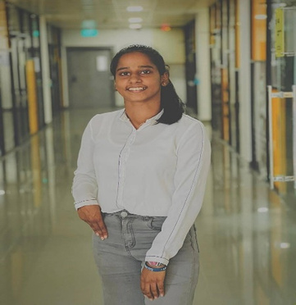

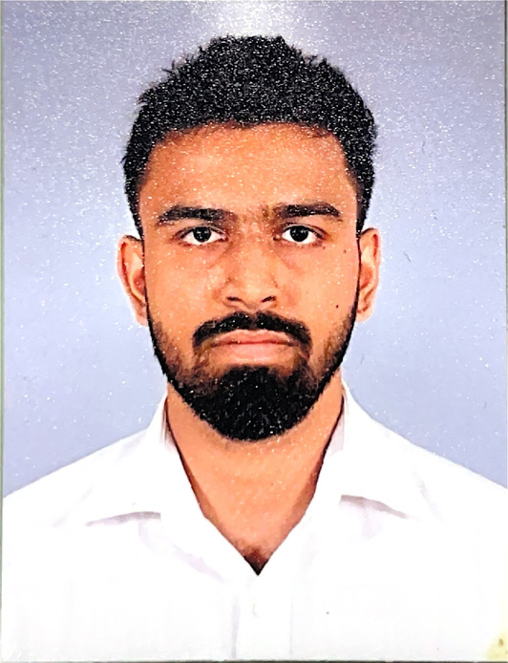


OUR TEAM
Supervisor
Co-Supervisor
Mr. Uditha Dharmakeerthi
Mr. Amila Senarathne
Ellewela A.V.H
Rathnayaka K.P.Y.N
Dissanayake D.T.D
Silva K.H.L.D
12/3/2024
‹#›

Slide 3

Content
Introduction
Research Question
Objectives
System Overview Diagram
Technologies
Individual Components Section
Commercialization Aspects
12/3/2024
‹#›

Slide 4

1. INTRODUCTION
The rising demand for reliable delivery services highlights the need for efficient logistics.
Unreliable delivery, poor routing, and tracking issues cause customer dissatisfaction.
AI and ML streamline processes, boost accuracy, and cut costs.
Better communication and feedback improve customer experience.
Optimize delivery with voice automation, fleet management, and CSAT analysis.
12/3/2024
‹#›
Notes:
4

Slide 5

2. RESEARCH QUESTION
How can the integration of advanced technologies, such as AI, Machine Learning, and automated systems, enhance the efficiency and effectiveness of the item delivery process in eCommerce?
12/3/2024
‹#›

Slide 6

3. OBJECTIVES
Sub Objectives
To Implement an automated voice activation system for the courier service to enhance delivery time prediction.
To Recognize the employee behavior and identify the improvements as a percentage.
To Implement a fleet management system with path optimization and delivery time prediction.
To Analyze customer satisfaction(CAST) regarding the item delivery though voice-based feedback.
Main Objective
To Implement a system to increase the effectiveness and efficiency in item delivery process
12/3/2024
‹#›
Notes:
6

Slide 7

04
SYSTEM
OVERVIEW
12/3/2024
‹#›

Slide 8
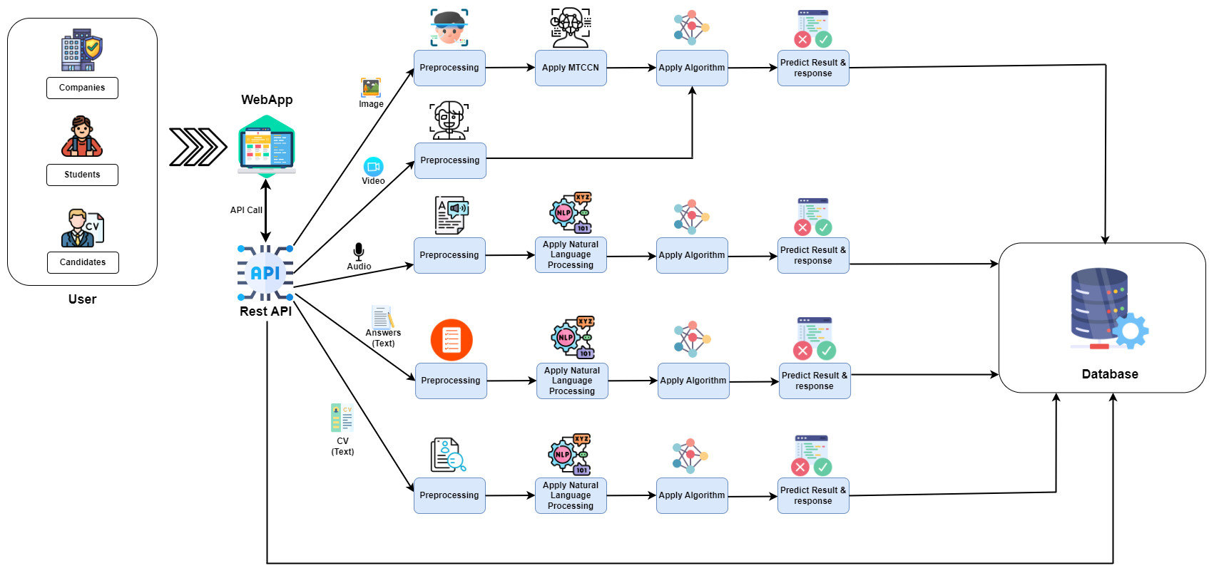
shop
12/3/2024
‹#›

Slide 9





05 TECHNOLOGIES
12/3/2024
‹#›
Notes:
9

Slide 10
06
INDIVIDUAL
COMPONENTS
12/3/2024
‹#›

Slide 11
Student Must add a professional photo to this cage
BSc (Hons) Degree in Information Technology (specialization in Information Technology )
IT21361272 | Ellewela A.V.H
12/3/2024
‹#›
Notes:
11

Slide 12

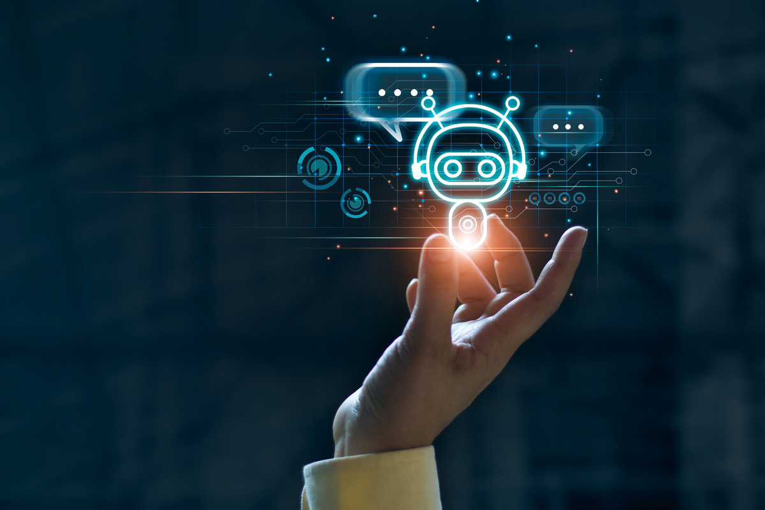
COMPONENT 01
Implement an automated voice system activation system for the courier service to enhance delivery time prediction.
IT21361272 | Ellewela A.V.H | 24-25J-298
‹#›
12/3/2024
‹#›
Notes:
12

Slide 13
BACKGROUND
Customers expect accurate, real-time delivery updates in today's eCommerce landscape.
Manual tracking and updates lead to delays and inaccurate delivery time predictions.
. Voice automation boosts delivery accuracy and satisfaction.
RESEARCH GAP
The research gap is in the incomplete coverage of delivery time estimation research, particularly in automated system confirmation, call generation, and delivery time identification. This calls for further research on integrated models and systems for accurate delivery time estimation.
IT21361272 | Ellewela A.V.H | 24-25J-298
‹#›
12/3/2024
‹#›

Slide 14

RESEARCH PROBLEM
Manual tracking causes delays and inaccurate delivery predictions in courier services, leading to customer dissatisfaction. An automated voice activation system can improve real-time updates and accuracy, addressing this issue?
IT21361272 | Ellewela A.V.H | 24-25J-298
‹#›
12/3/2024
‹#›
Notes:
14

Slide 15
SPECIFIC OBJECTIVES
To implement an automated voice activation system that improves delivery time prediction by providing real-time updates, enhancing communication between couriers and customers, and ensuring accurate and timely delivery information.
IT21361272 | Ellewela A.V.H | 24-25J-298
‹#›
12/3/2024
‹#›

Slide 16
SUB OBJECTIVES
To Create a voice-activated system that allows users to interact with courier services to receive and manage delivery time predictions seamlessly.
To Enhance real-time communication between couriers and customers through voice-based updates, improving delivery accuracy and customer satisfaction.
IT21361272 | Ellewela A.V.H | 24-25J-298
‹#›
12/3/2024
‹#›

Slide 17
METHODOLOGY
IT21361272 | Ellewela A.V.H | 24-25J-298
‹#›
12/3/2024
‹#›
Notes:
17

Slide 18
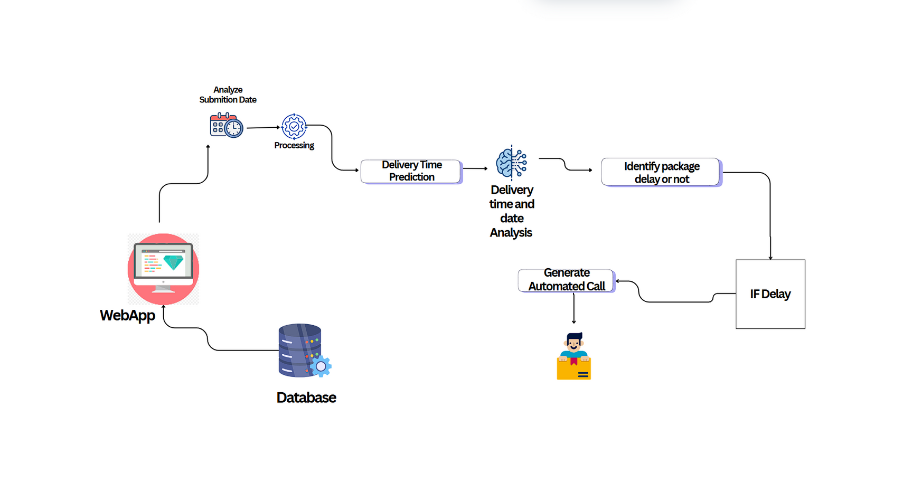
COMPONENT DIAGRAM
IT21361272 | Ellewela A.V.H | 24-25J-298
‹#›
12/3/2024
‹#›

Slide 19


COMPLETION & FUTURE WORKS
Completion of the component
Delivery Data Collection
Completed training and fine-tuning models for delivery time predication
Implemented delivery delay estimation
Future works of the component
Integrate models into an automated voice activation system
Develop and implement real-time update system
Integrate Backend and Frontend
IT21361272 | Ellewela A.V.H | 24-25J-298
‹#›
12/3/2024
‹#›

Slide 20
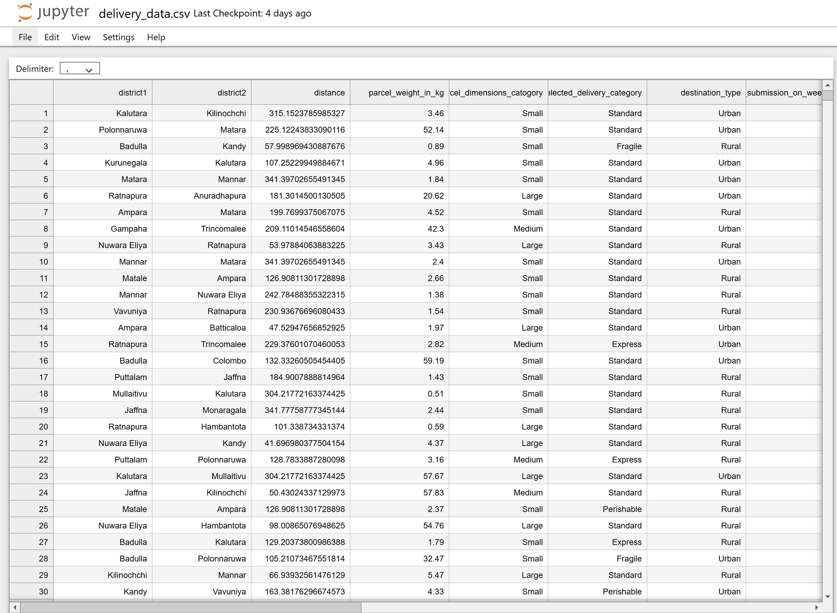
EVIDENCE OF COMPLETION
Data Gathering
IT21361272 | Ellewela A.V.H | 24-25J-298
‹#›
12/3/2024
‹#›

Slide 21
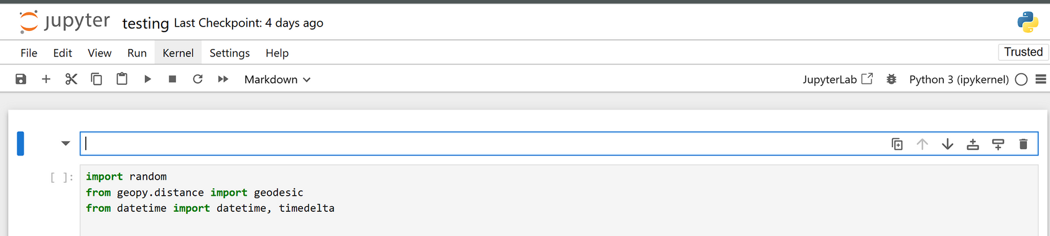
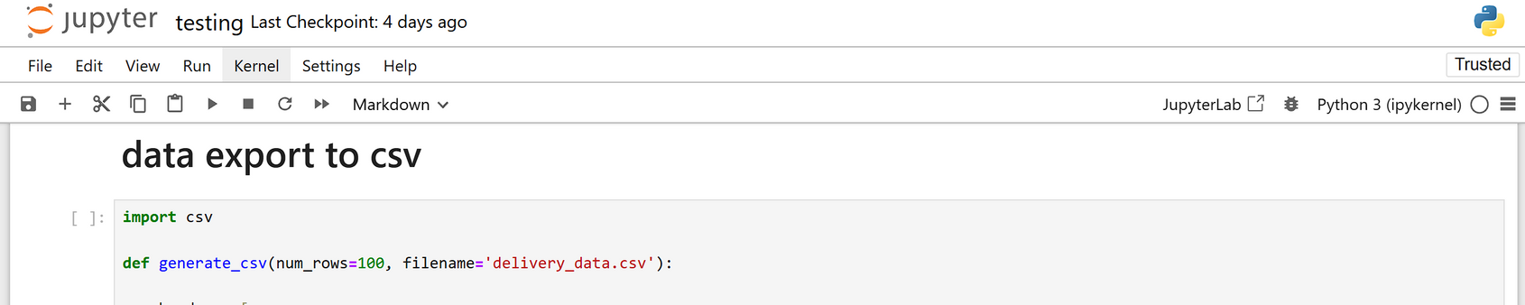
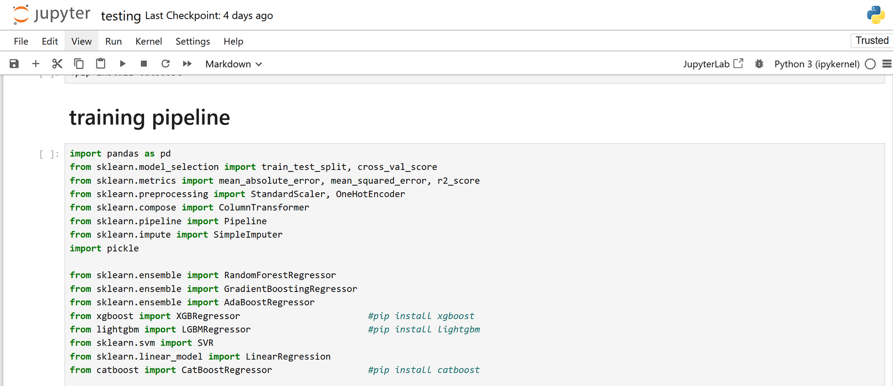
Import Libraries
IT21361272 | Ellewela A.V.H | 24-25J-298
‹#›
12/3/2024
‹#›

Slide 22
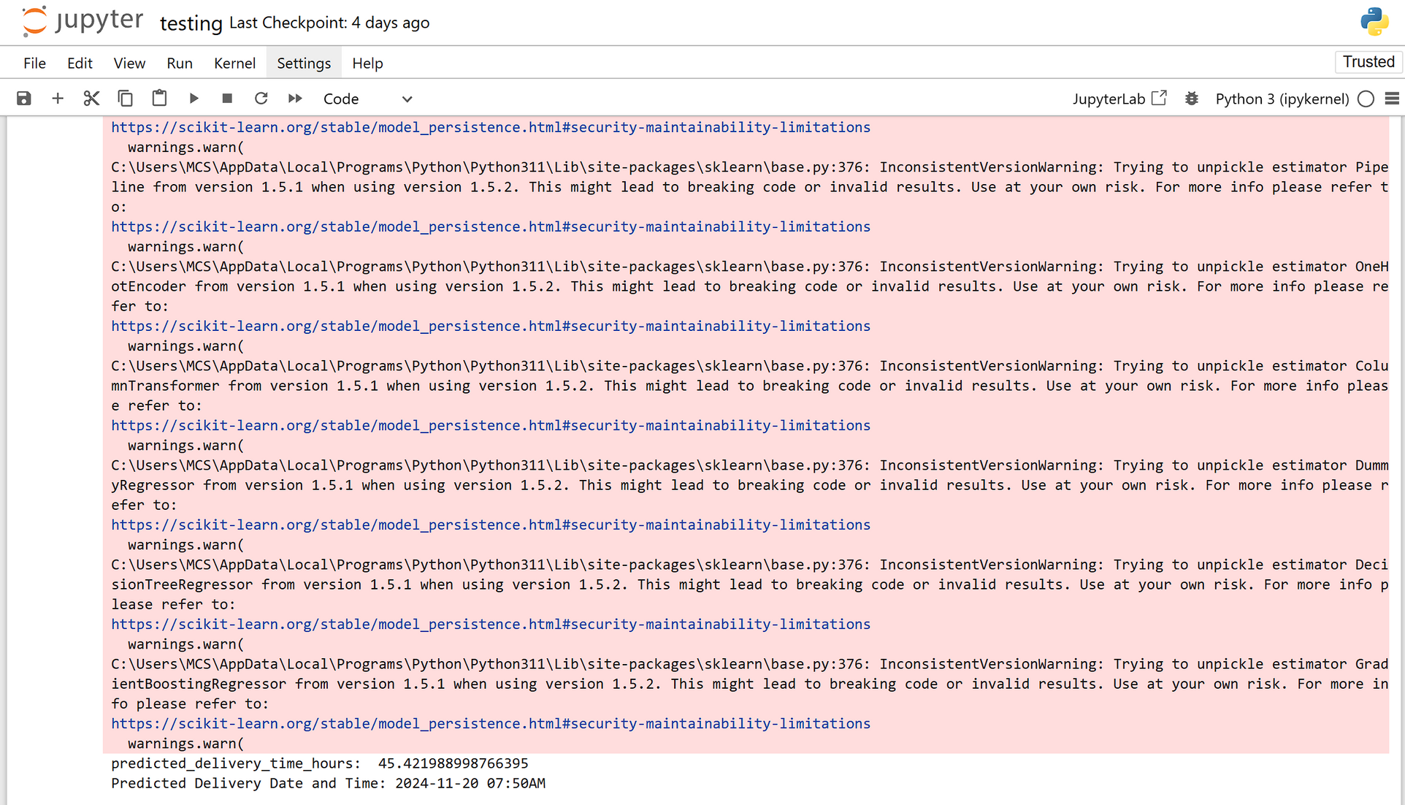
Delivery time Prediction
IT21361272 | Ellewela A.V.H | 24-25J-298
‹#›
12/3/2024
‹#›

Slide 23
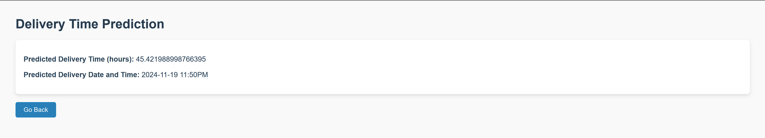
Delivery time predication
IT21361272 | Ellewela A.V.H | 24-25J-298
‹#›
12/3/2024
‹#›

Slide 24
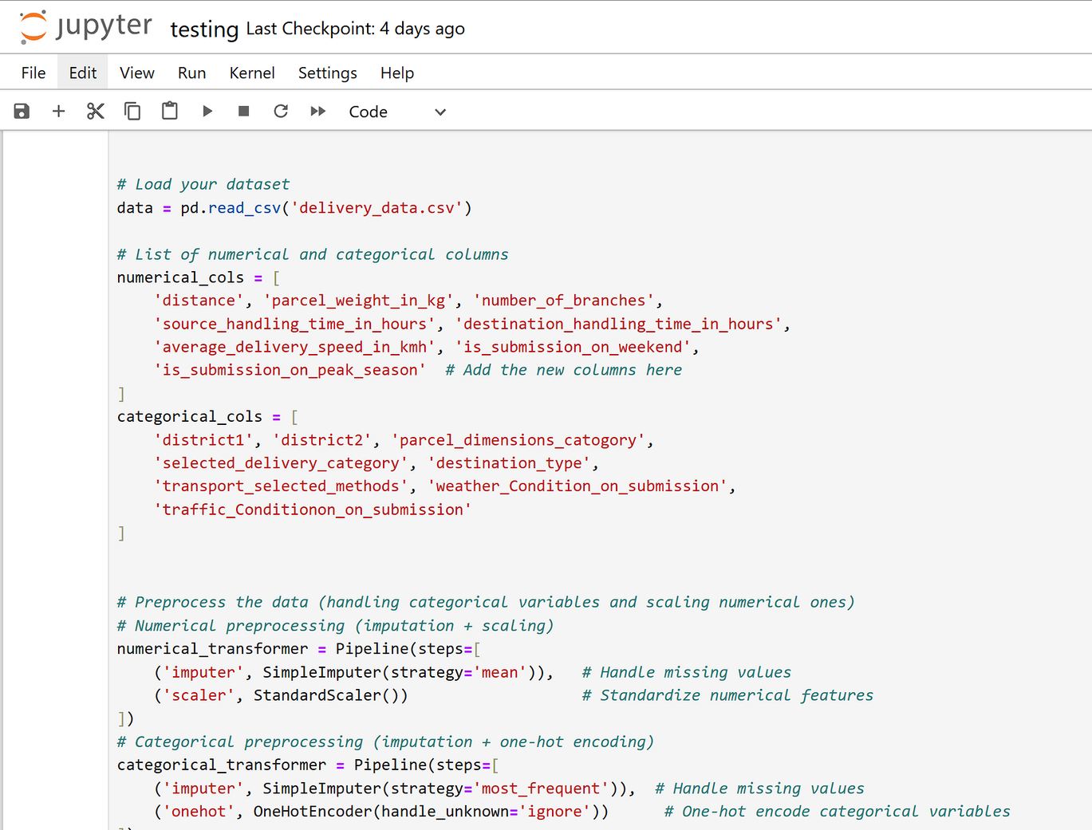
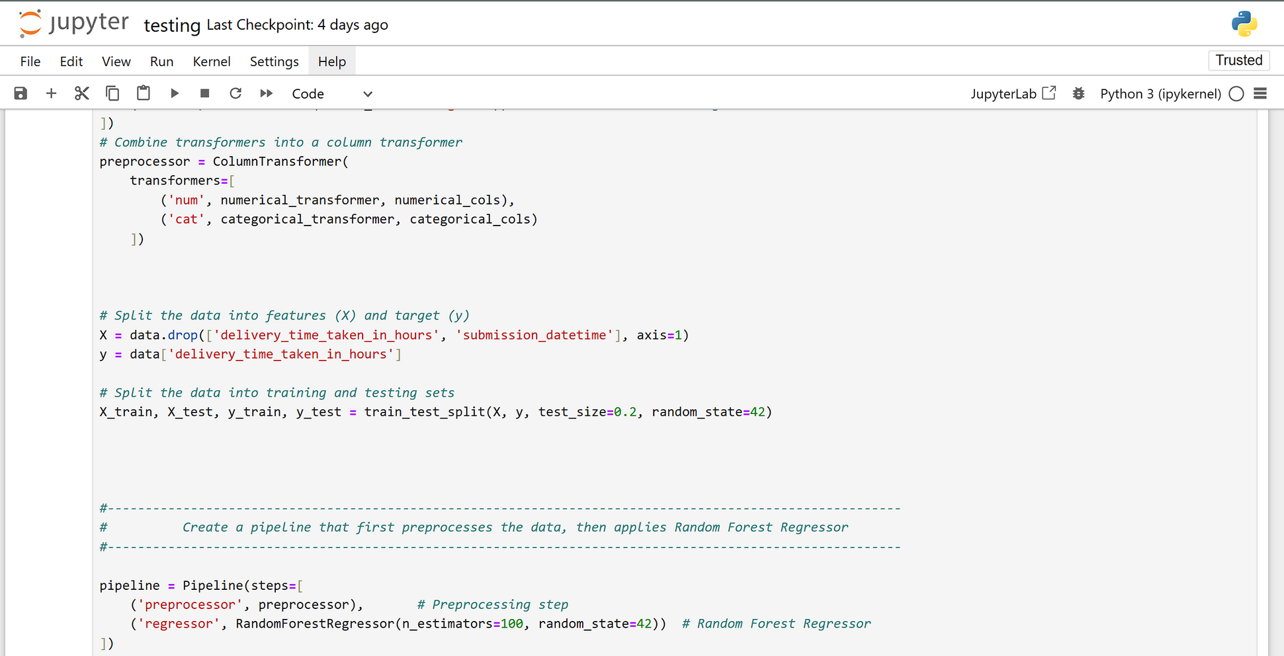
Model Training & Delivery time Prediction
IT21361272 | Ellewela A.V.H | 24-25J-298
‹#›
12/3/2024
‹#›

Slide 25
TECHNOLIGIES USED
Delivery time prediction: Time prediction model, fine-tuned with dataset .
Time Prediction: Random Forest Regressor algorithm .
Automated Voice Activation System: Asterisk-PBX
IT21361272 | Ellewela A.V.H | 24-25J-298
‹#›
12/3/2024
‹#›

Slide 26
COMPONENT SPECIFIC REQUIREMENTS
Functional
Non Functional
Voice Command Processing
Delivery Time Prediction
Proactive Delay Notifications
Real-Time Data Updates
Customer Query Resolution
Performance
Usability
Scalability
Security
Reliability
IT21361272 | Ellewela A.V.H | 24-25J-298
‹#›
12/3/2024
‹#›

Slide 27
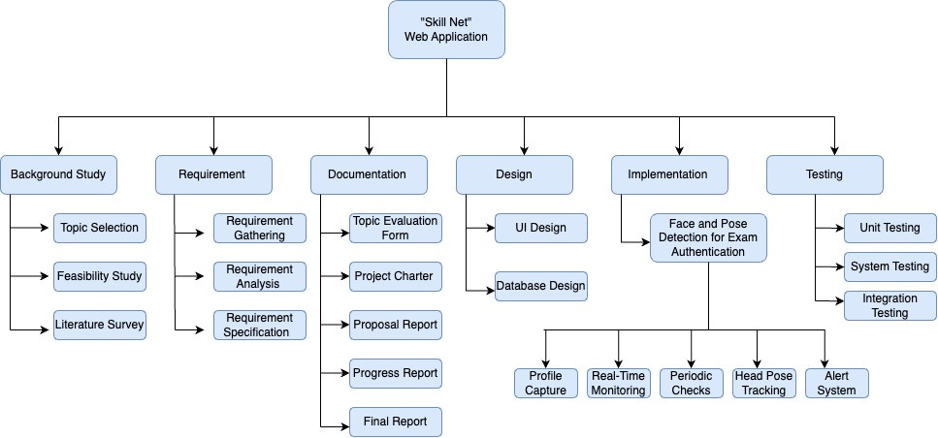
WORK BREAKDOWN CHART
IT21361272 | Ellewela A.V.H | 24-25J-298
‹#›
12/3/2024
‹#›

Slide 28
REFERENCES
[1] Employee Recognition, Task Performance, and OCB: Mediated and Moderated by Pride(https://www.mdpi.com/2071-1050/14/3/1631 )
[2] The Key Strategies for Measuring Employee Performance in Companies: A Systematic Review(https://www.researchgate.net/publication/367528681 )
[3] Role of Work Breaks in Well-Being and Performance(https://www.researchgate.net/publication/361913348_ )
[4] Putting the System Into Performance Management Systems: A Review and Agenda for Performance Management Research(https://www.researchgate.net/publication/323040479_ )
[5] Employee Recognition and Performance:A Field Experiment(https://people.duke.edu/~dandan/webfiles/PapersPayoff/Scarcity_02June2015.pd )
IT21361272 | Ellewela A.V.H | 24-25J-298
‹#›
12/3/2024
‹#›

Slide 29

Student Must add a professional photo to this cage
BSc (Hons) Degree in Information Technology (specialization in Information Technology )
IT21031748 | Rathnayaka k.p.y.n
12/3/2024
‹#›
Notes:
29

Slide 30

COMPONENT 02
Recognized the employee behaviour and identify the improvements as a percentage.
IT21031748 | Rathnayaka K.P.Y.N | 24-25J-298
‹#›
12/3/2024
‹#›
Notes:
30

Slide 31
BACKGROUND
Track key metrics such as attendance, delivery times, task completion, and customer feedback.
Analyze employee behaviour across various time frames (peak hours, holidays, etc.) to identify patterns and workload distribution.
Evaluate the need for additional staffing during peak times or reduced staffing during off-peak periods using historical data
RESEARCH GAP
The research gap highlights a lack of comprehensive systems integrating employee performance tracking, workload analysis, coverage optimization during peak times, and forecasted scheduling tools, which existing studies address only partially.
IT21031748 | Rathnayaka K.P.Y.N | 24-25J-298
‹#›
12/3/2024
‹#›

Slide 32

RESEARCH PROBLEM
Machine learning enhances workforce management by predicting staffing needs, optimizing employee performance, and improving delivery times through behavior analysis, key performance metrics, and predictive staffing solutions. ?
IT21031748 | Rathnayaka K.P.Y.N | 24-25J-298
‹#›
12/3/2024
‹#›

Slide 33
SPECIFIC OBJECTIVE
To develop a machine learning-based system that predicts future staffing needs and enhances employee performance by analysing behaviour patterns, thereby improving operational efficiency and resource allocation.
SUB OBJECTIVES
Data Collection: Collect and organize attendance records, task completion rates, and work schedules..
Behaviour Analysis : Analyze employee behavior during peak hours, holidays, and regular times to assess workload distribution.
Machine Learning Implementation: Implement machine learning to predict staffing needs and optimize workforce efficiency.
Performance Forecasting: Provide forecasts to enhance staffing schedules and support workforce planning.platform
IT21031748 | Rathnayaka K.P.Y.N | 24-25J-298
‹#›
12/3/2024
‹#›

Slide 34
METHODOLOGY
IT21031748 | Rathnayaka K.P.Y.N | 24-25J-298
‹#›
12/3/2024
‹#›

Slide 35
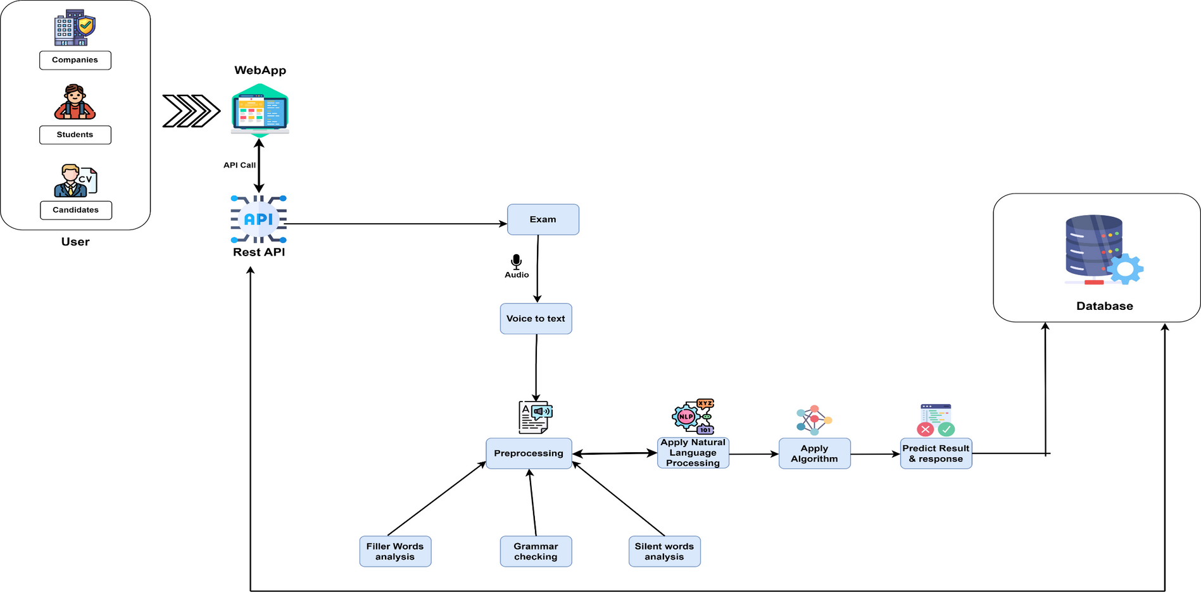
COMPONENT DIAGRAM
IT21031748 | Rathnayaka K.P.Y.N | 24-25J-298
‹#›
12/3/2024
‹#›

Slide 36
COMPLETION AND FUTURE WORKS
Completion of the component
Collect data manually and create data set
Completed data preprocessing using truncation and padding
Completed data training and fine-tuning text to text generation
Future works of the component
Voice Input Processing
Ensure accuracy and performance
Implementing the integration between the backend and frontend components
IT21031748 | Rathnayaka K.P.Y.N | 24-25J-298
‹#›
12/3/2024
‹#›

Slide 37
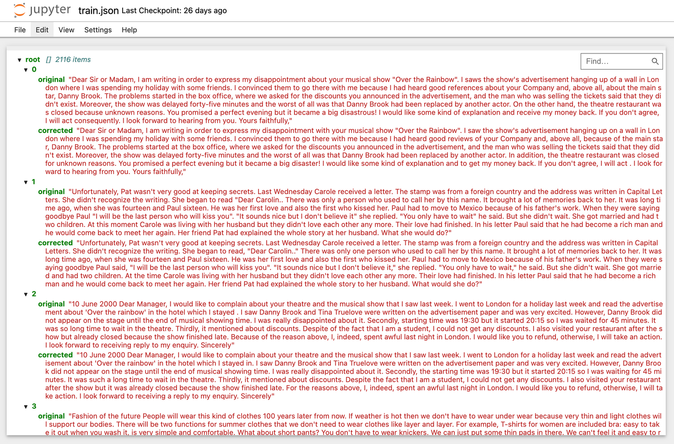
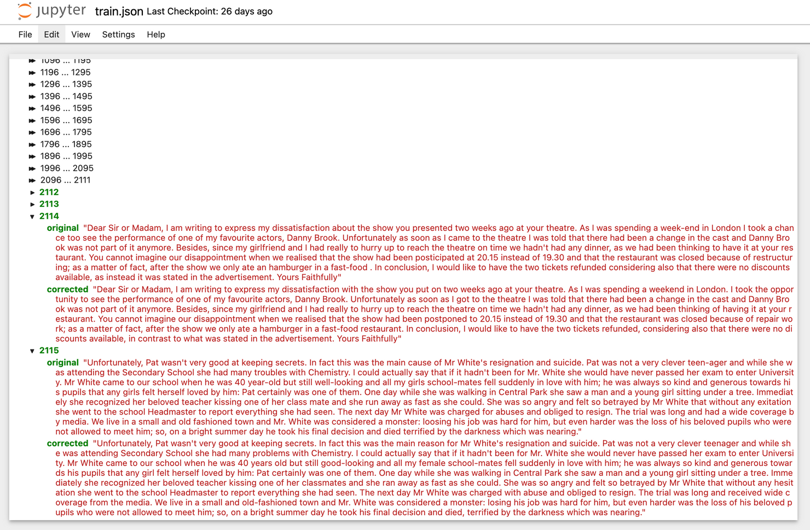
EVIDENCE OF COMPLETION
Data Gathering
IT21031748 | Rathnayaka K.P.Y.N | 24-25J-298
‹#›
12/3/2024
‹#›

Slide 38
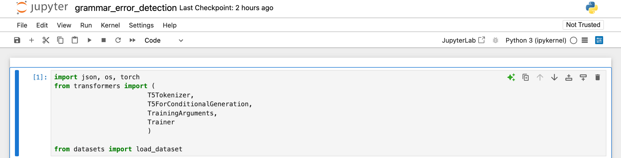
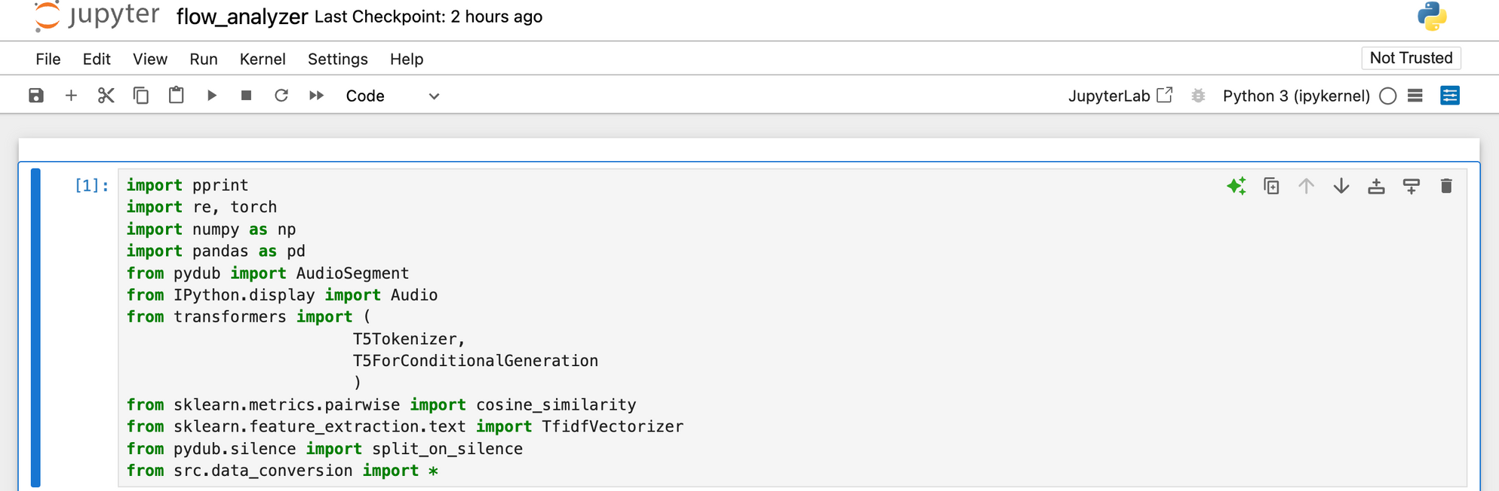
IMPORTED LIBRARIES
IT21031748 | Rathnayaka K.P.Y.N | 24-25J-298
099
‹#›
12/3/2024
‹#›

Slide 39
DATA TRAINING AND PREPROCESSING
IT21031748 | Rathnayaka K.P.Y.N | 24-25J-298
‹#›
12/3/2024
‹#›

Slide 40
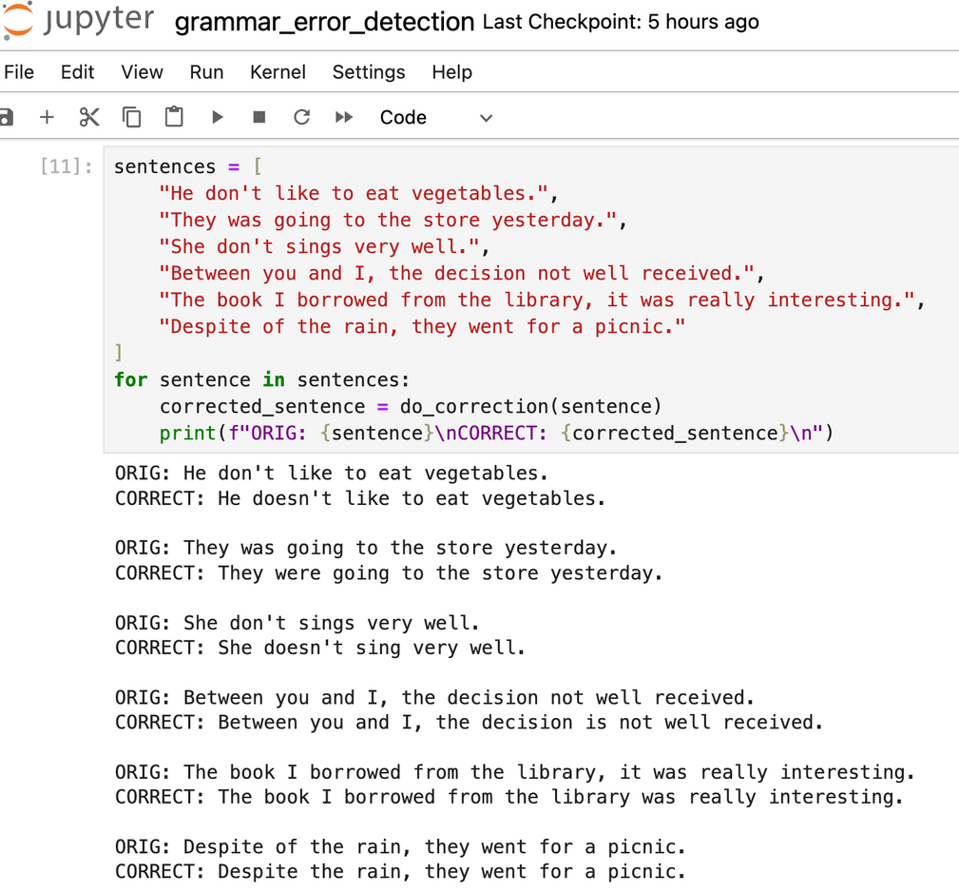
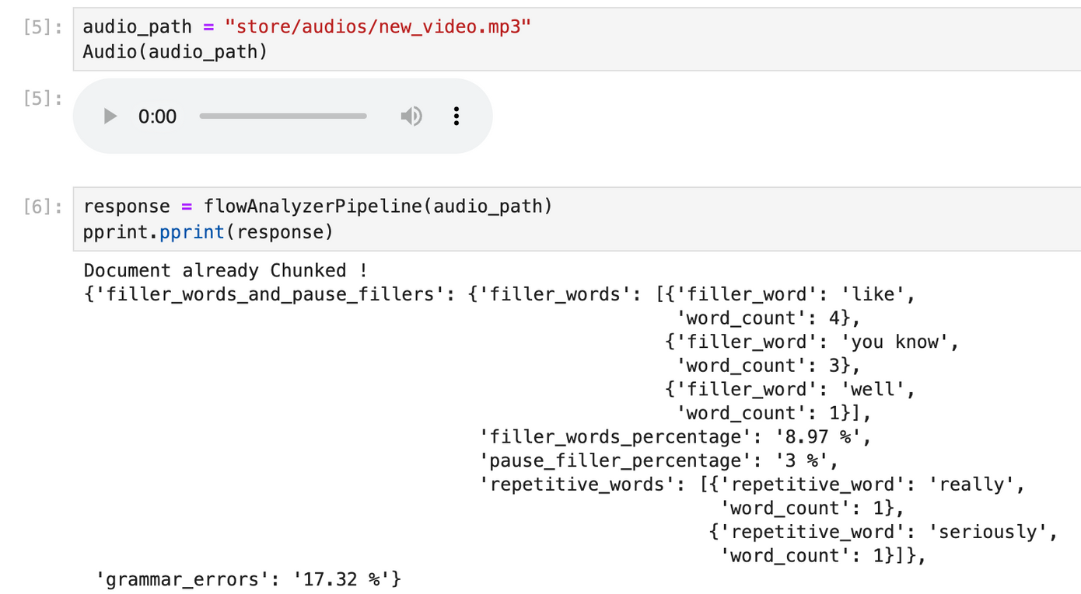
DISPLAY THE RESULTS
IT21031748 | Rathnayaka K.P.Y.N | 24-25J-298
‹#›
12/3/2024
‹#›

Slide 41
COMPONENT SPECIFIC REQUIREMENTS
Functional Requirements
Non-Functional Requirements
Voice Input Processing
NLP Analysis
Scoring System
Integration
Reliability
Availability
Maintainability
Security
IT21031748 | Rathnayaka K.P.Y.N | 24-25J-298
‹#›
12/3/2024
‹#›

Slide 42
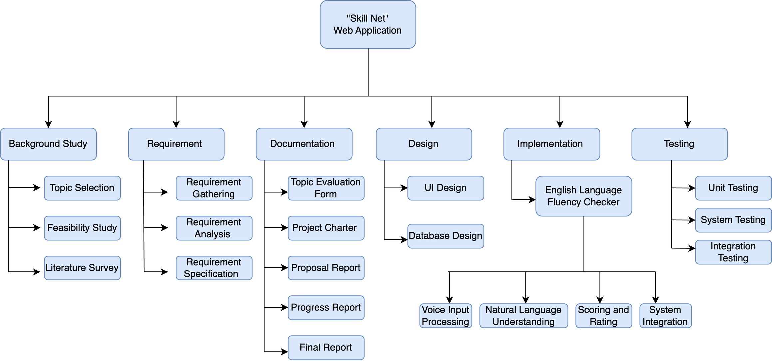
WORK BREAKDOWN CHART
IT21031748 | Rathnayaka K.P.Y.N | 24-25J-298
‹#›
12/3/2024
‹#›

Slide 43
REFERENCES
[1] Employee Recognition, Task Performance, and OCB: Mediated and Moderated by Pride(https://www.mdpi.com/2071-1050/14/3/1631 )
[2] The Key Strategies for Measuring Employee Performance in Companies: A Systematic Review(https://www.researchgate.net/publication/367528681 )
[3] Role of Work Breaks in Well-Being and Performance(https://www.researchgate.net/publication/361913348_ )
[4] Putting the System Into Performance Management Systems: A Review and Agenda for Performance Management Research(https://www.researchgate.net/publication/323040479_ )
[5] Employee Recognition and Performance:A Field Experiment(https://people.duke.edu/~dandan/webfiles/PapersPayoff/Scarcity_02June2015.pd )
IT21031748 | Rathnayaka K.P.Y.N | 24-25J-298
‹#›
12/3/2024
‹#›

Slide 44
Student Must add a professional photo to this cage
BSc (Hons) Degree in Information Technology (specialization in Information Technology )
IT21165948 | D.T.D DISSANAYAKE
12/3/2024
‹#›
Notes:
44

Slide 45

COMPONENT 03
Implement a fleet management system with delivery path optimization and weather prediction
IT21165948 | D.T.D Dissanayake | 24-25J-298
‹#›
12/3/2024
‹#›
Notes:
45

Slide 46
BACKGROUND
Current assessment systems in e-learning platforms primarily rely on static methods.
Which compromises the reliability of assessments.
As a solution developing advanced mechanisms that evaluate meaning and context rather than just keywords or patterns.
IT21165948 | D.T.D Dissanayake | 24-25J-298
‹#›
12/3/2024
‹#›

Slide 47

RESEARCH PROBLEM
How can e-learning platforms evolve beyond static methods to assess deeper understanding and higher-order thinking skills?
How can assessment systems be enhanced to accurately and effectively evaluate complex descriptive-type responses?
IT21165948 | D.T.D Dissanayake | 24-25J-298
‹#›
12/3/2024
‹#›

Slide 48




OBJECTIVE
Sub objectives
Preprocess and analyze user's response.
Develop a model to accurately evaluate and score user responses against predefined correct answers.
Compare user responses to correct answers.
Calculate an accuracy percentage for individual response.
Aggregate individual percentages to determine an overall exam score.
IT21165948 | D.T.D Dissanayake | 24-25J-298
‹#›
12/3/2024
‹#›
Notes:
48

Slide 49
METHODOLOGY
IT21165948 | D.T.D Dissanayake | 24-25J-298
‹#›
12/3/2024
‹#›

Slide 50
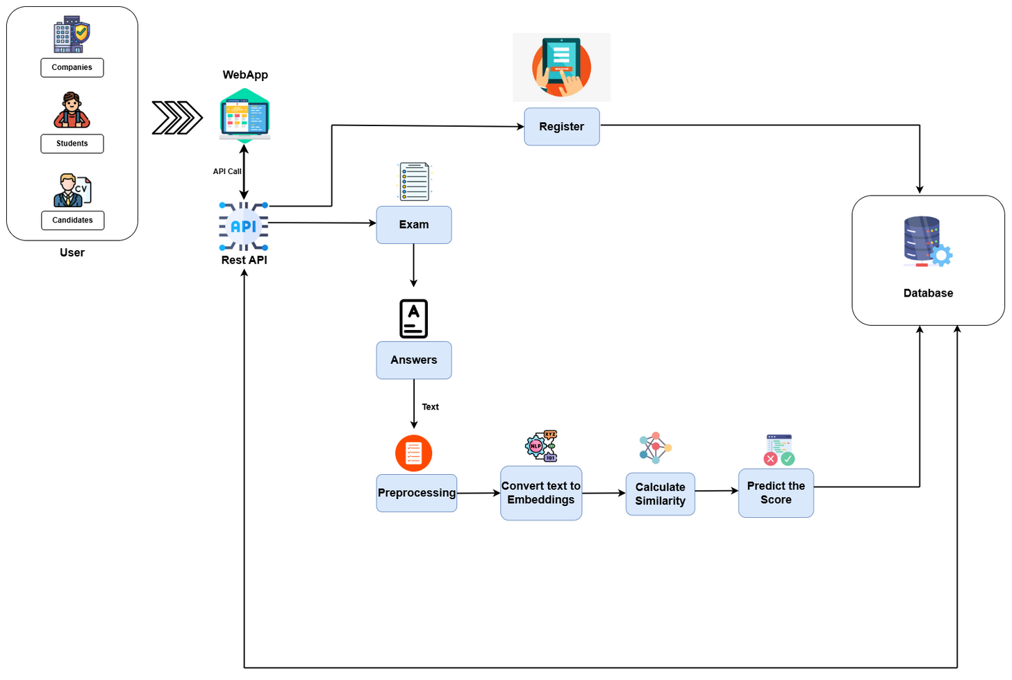
COMPONENT DIAGRAM
IT21165948 | D.T.D Dissanayake | 24-25J-298
‹#›
12/3/2024
‹#›

Slide 51


COMPLETION & FUTURE WORKS
Questions and Answers Data Gathering
Data Preprocessing
Fine-tune model for calculating similarity between two texts
Integrate model into e-learning system
Integrate Backend and Frontend
IT21165948 | D.T.D Dissanayake | 24-25J-298
‹#›
12/3/2024
‹#›

Slide 52

TOOLS AND TECHNOLIGIES
NLP Techniques: Text Embeddings, Cosine Similarity
Text Embedding: Alibaba-NLP/gte-base-en-v1.5
Model Training Framework: PyTorch
Semantic Matching Algorithm : Cosine Similarity
Data Standardization Tools: Pandas
IT21165948 | D.T.D Dissanayake | 24-25J-298
‹#›
12/3/2024
‹#›

Slide 53
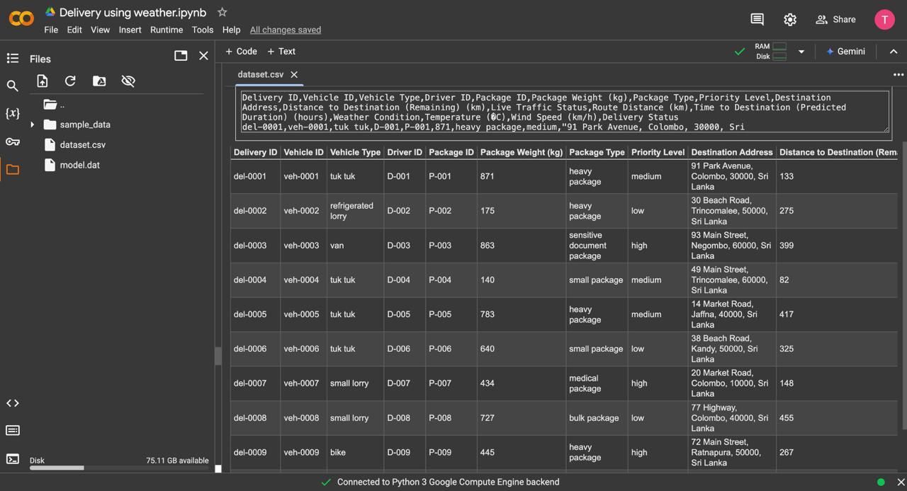
Gathered Data
IT21165948 | D.T.D Dissanayake | 24-25J-298
‹#›
12/3/2024
‹#›

Slide 54
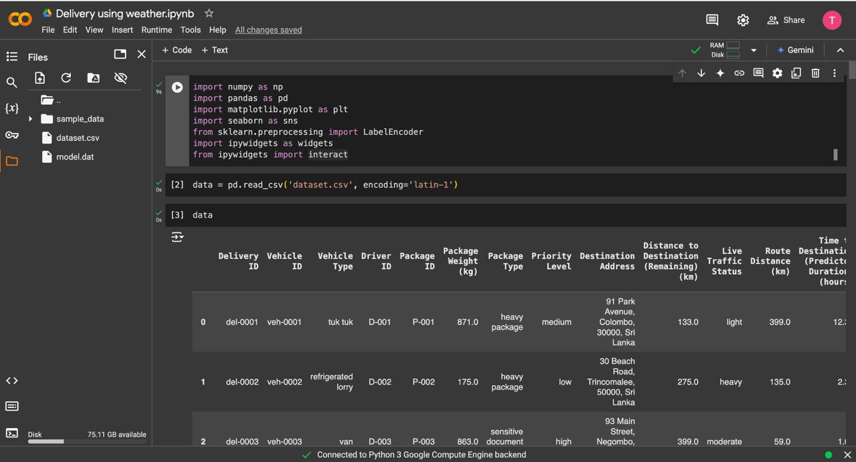
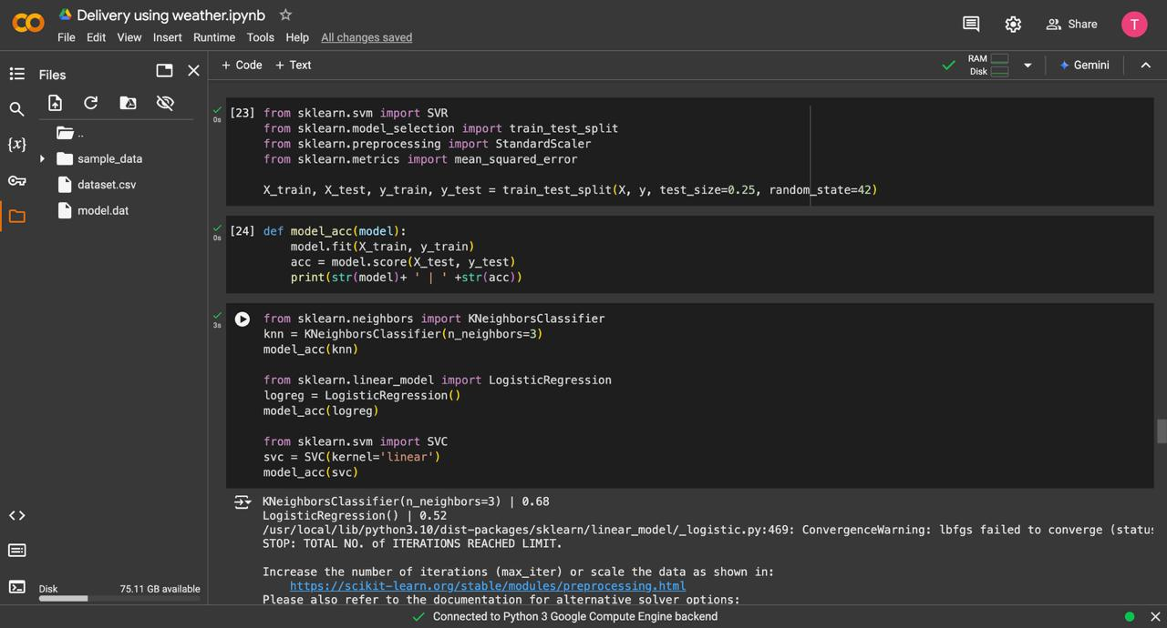
Import Libraries
IT21165948 | D.T.D Dissanayake | 24-25J-298
‹#›
12/3/2024
‹#›

Slide 55
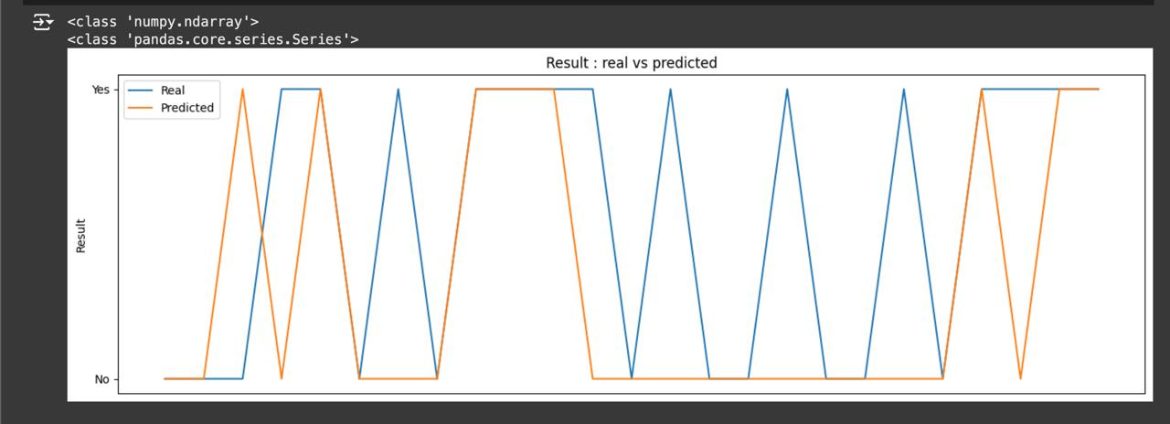
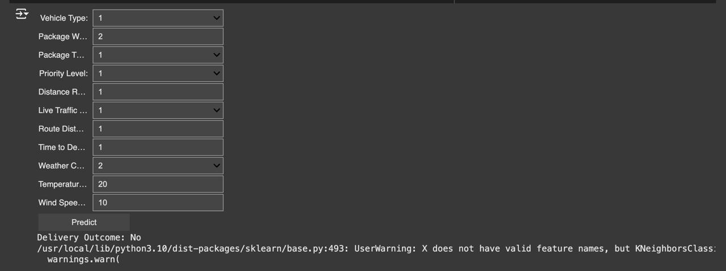
Best Epoch Visuals
IT21165948 | D.T.D Dissanayake | 24-25J-298
‹#›
12/3/2024
‹#›

Slide 56
COMPONENT SPECIFIC REQUIREMENTS
Functional Requirements
Tokenize Inputs
Answer Comparison
Accuracy Calculation
Result Aggregation
IT21165948 | D.T.D Dissanayake | 24-25J-298
‹#›
12/3/2024
‹#›

Slide 57
REFERENCES
[1] A Real-time Vehicle Routing Model for a Courier Service Problem
(https://www.researchgate.net/publication/227281341_ )
[2] Research on Optimization of Vehicle Routing Problem for Ride-sharing Taxi
(https://www.sciencedirect.com/science/article/pii/S1877042812010038)
[3] Case study on delivery time determination using a machine learning approach in small batch production
(https://link.springer.com/article/10.1007/s10845-023-02290-2)
[4] Boosting Algorithms for Delivery Time Prediction in Transportation Logistics
(https://ieeexplore.ieee.org/document/9346325)
IT21165948 | D.T.D Dissanayake | 24-25J-298
‹#›
12/3/2024
‹#›

Slide 58
Student Must add a professional photo to this cage
BSc (Hons) Degree in Information Technology (specialization in Information Technology )
IT21374838 | SILVA K.H.L.D
12/3/2024
‹#›
Notes:
58

Slide 59
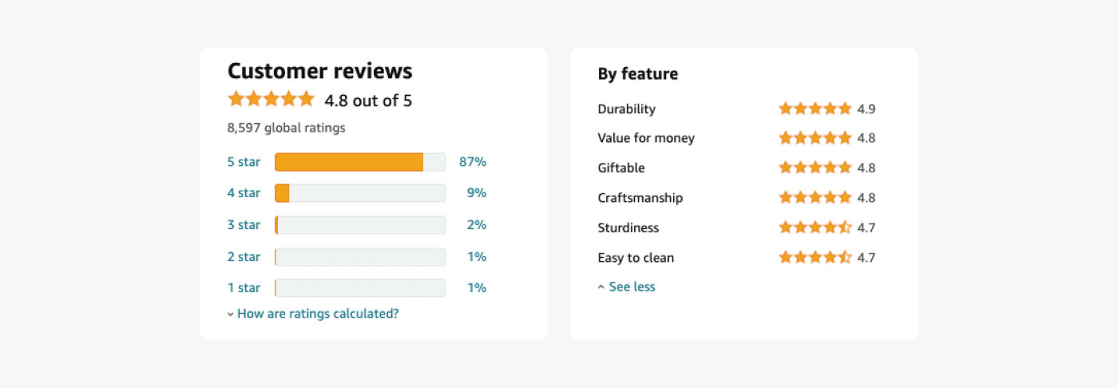
COMPONENT 04
Analyzing Customer Satisfaction (CSAT) Through Voice-based Feedback & Validity Checking
IT21374838 | Silva K.H.L.D | 24-25J-298
‹#›
12/3/2024
‹#›
Notes:
59

Slide 60
BACKGROUND
Traditional methods of customer feedback collection, like surveys, are limited in real-time analysis and engagement.
Voice-based feedback offers a more interactive way for customers to express their opinions, leading to richer data.
Best use of AI and NLP
RESEARCH GAP
Integrating AI, ML, NLP, and image validation in logistics enhances customer feedback by combining voice analysis with visual proof. This unified system reduces fraud, improves issue validation, and boosts customer satisfaction while optimizing resources.
IT21374838 | Silva K.H.L.D | 24-25J-298
‹#›
12/3/2024
‹#›

Slide 61

RESEARCH PROBLEM
How can AI-based object detection and voice feedback systems enhance performance in ?
IT21374838 | Silva K.H.L.D | 24-25J-298
‹#›
12/3/2024
‹#›

Slide 62

SPECIFIC OBJECTIVE
To enhance customer satisfaction by developing a system that accurately analyses voice-based feedback using AI and NLP & Object Validation
SUB OBJECTIVE​S
Develop a system to collect voice feedback.
Use NLP to analyze and categorize feedback.
Generate automated service improvement suggestions from feedback.
Object Detection Using CNN.
IT21374838 | Silva K.H.L.D | 24-25J-298
‹#›
12/3/2024
‹#›

Slide 63
METHODOLOGY
IT21374838 | Silva K.H.L.D | 24-25J-298
‹#›
12/3/2024
‹#›

Slide 64
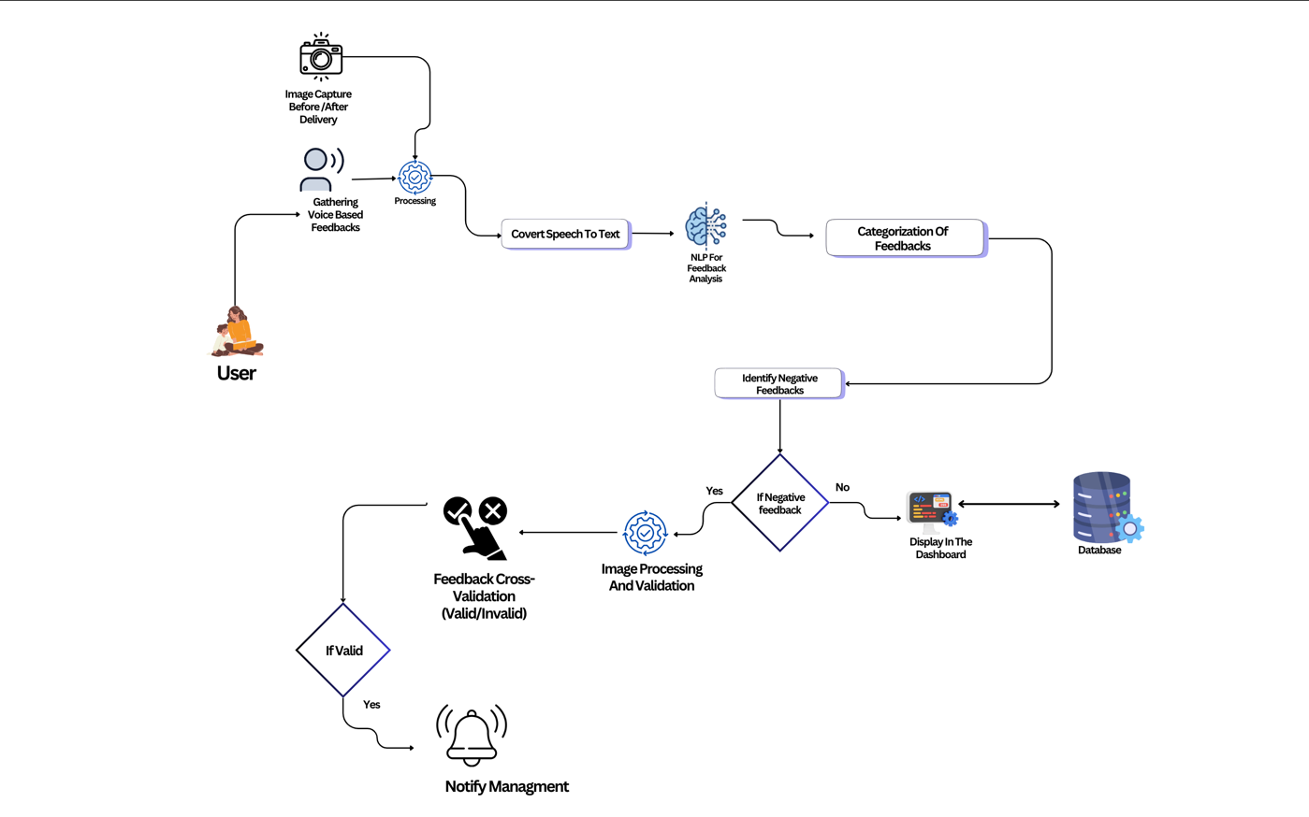
COMPONENT DIAGRAM
IT21374838 | Silva K.H.L.D | 24-25J-298
‹#›
12/3/2024
‹#›

Slide 65


COMPLETION AND FUTURE WORKS
Models For Classification and Object Detection
Data Gathering & Train Data Set .
UI Design & Prototype
Component Integration
Deployment In Cloud Environment
sssfIntegrate Backend and Fronten
IT21374838 | Silva K.H.L.D | 24-25J-298
‹#›
12/3/2024
‹#›

Slide 66
TECHNOLIGIES TO BE USED
Tenser Flow
Python
Azure
​
IT21374838 | Silva K.H.L.D | 24-25J-298
‹#›
12/3/2024
‹#›

Slide 67
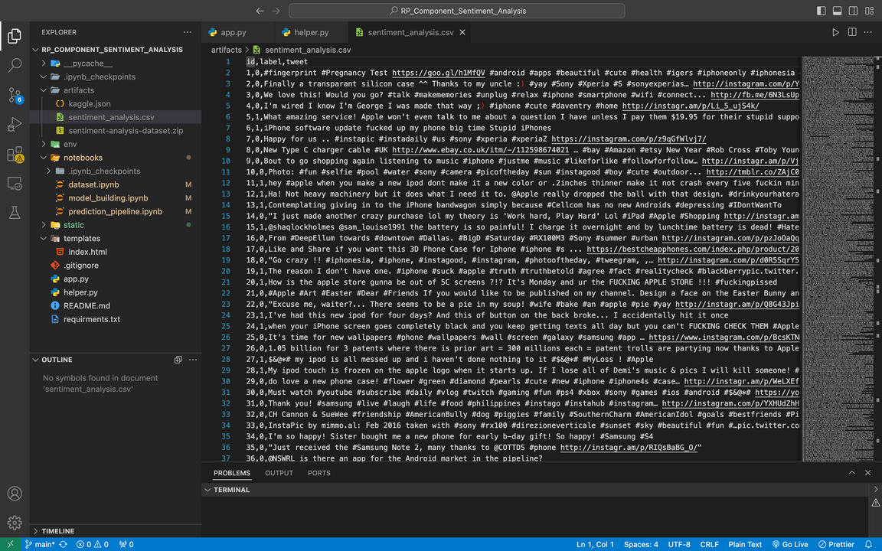
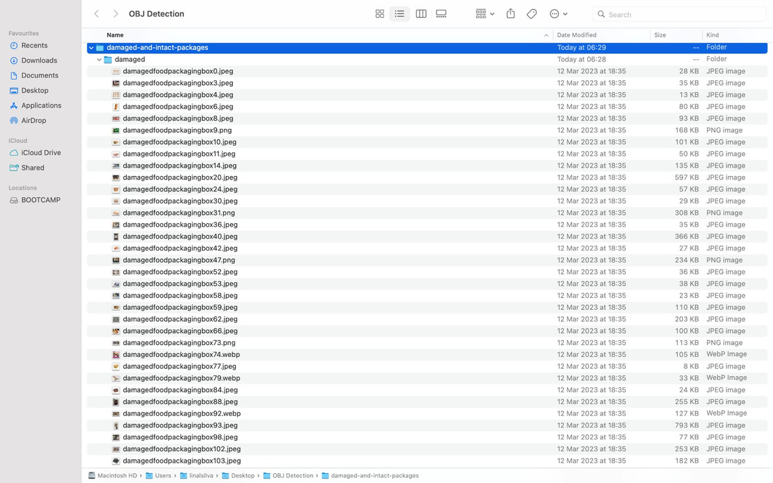
EVIDENCE OF COMPLETION
EVIDENCE OF COMPLETION
Data sets
IT21374838 | Silva K.H.L.D | 24-25J-298
‹#›
12/3/2024
‹#›

Slide 68
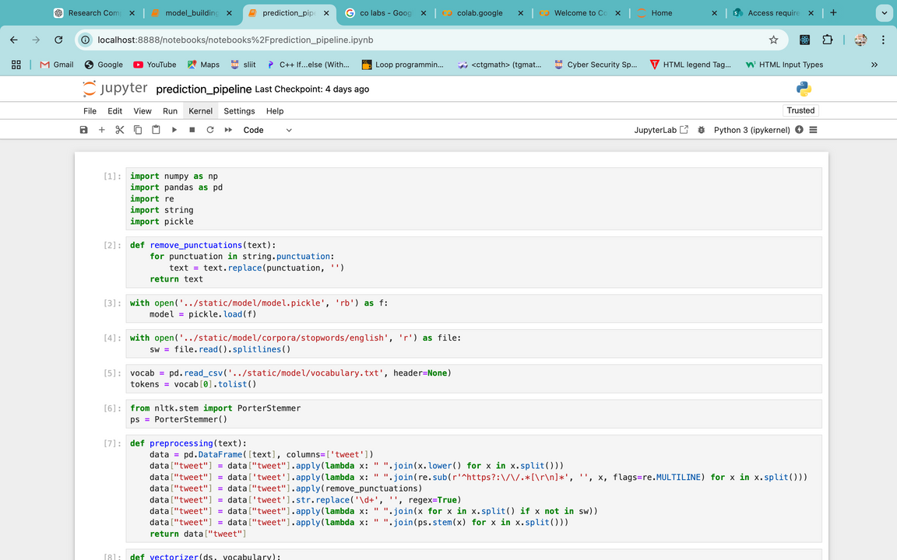
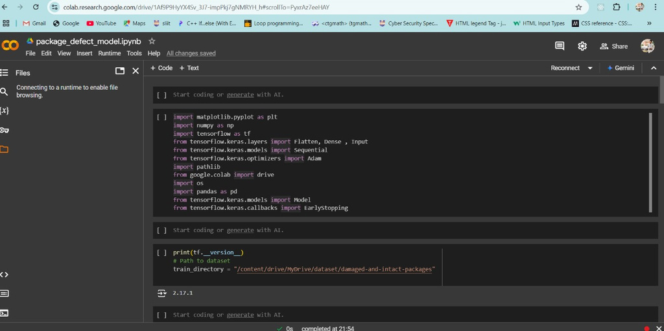
Import Libraries
IT21374838 | Silva K.H.L.D | 24-25J-298
‹#›
12/3/2024
‹#›

Slide 69
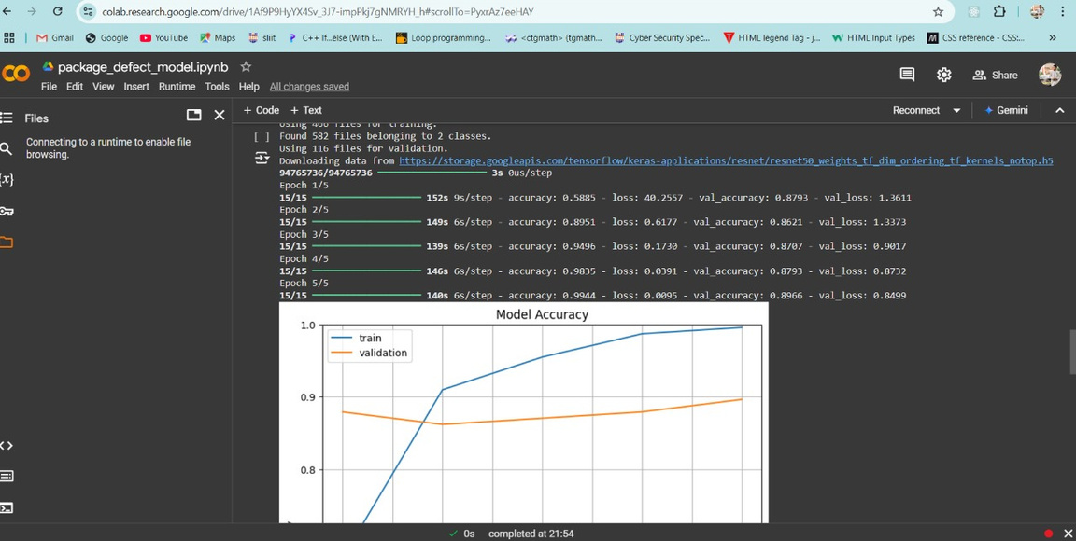
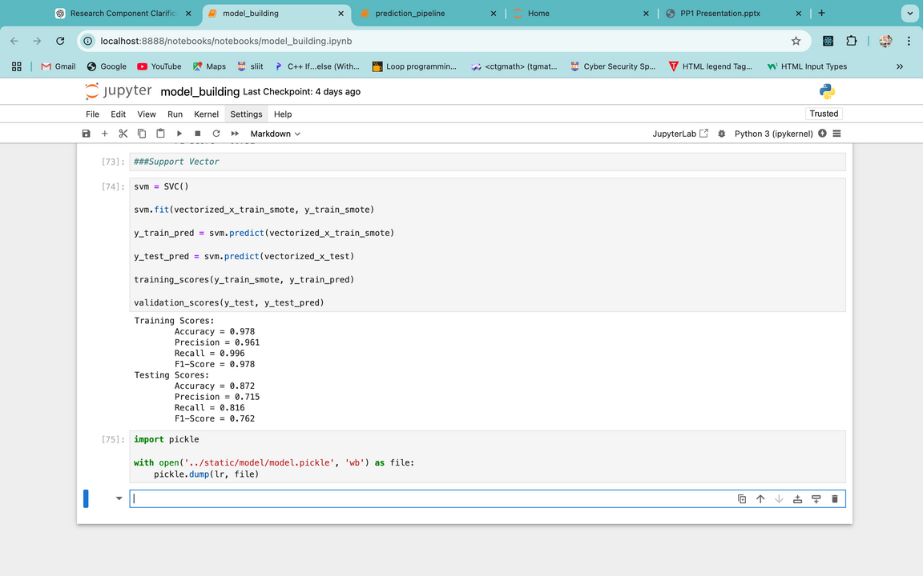
Model Accuracy
IT21374838 | Silva K.H.L.D | 24-25J-298
‹#›
12/3/2024
‹#›

Slide 70
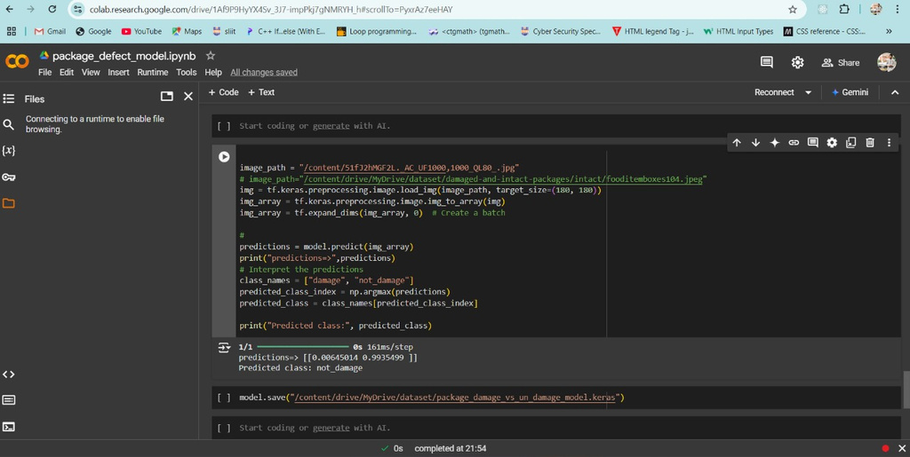
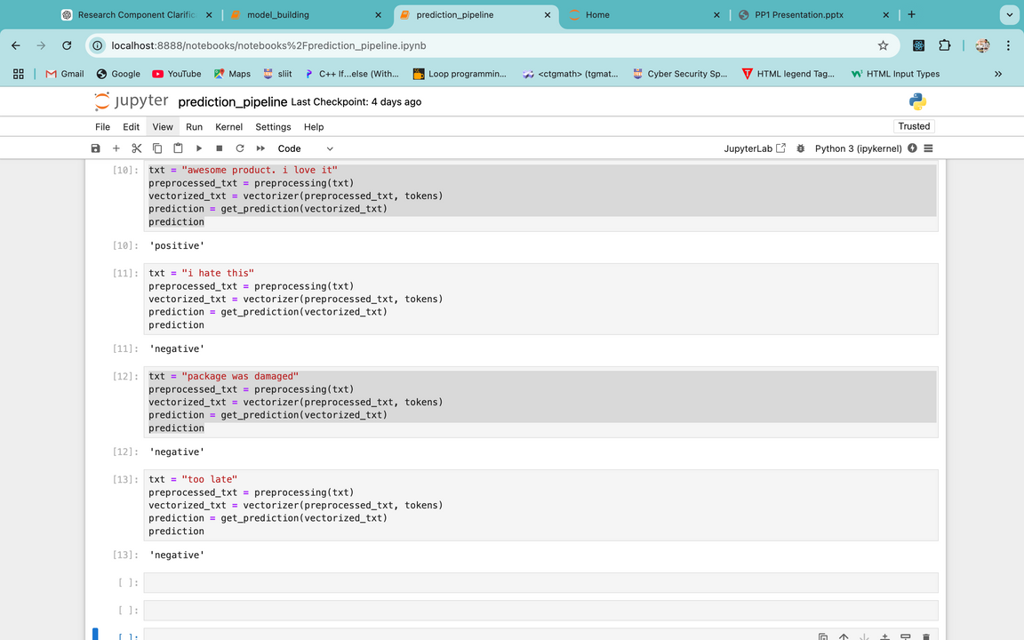
Output
IT21374838 | Silva K.H.L.D | 24-25J-298
‹#›
12/3/2024
‹#›

Slide 71
COMPONENT SPECIFIC REQUIREMENTS
Functional Requirements
Feedback Classification
Object Detection
Enhanced Data Filtering
Accuracy and Validation
IT21374838 | Silva K.H.L.D | 24-25J-298
‹#›
12/3/2024
‹#›

Slide 72
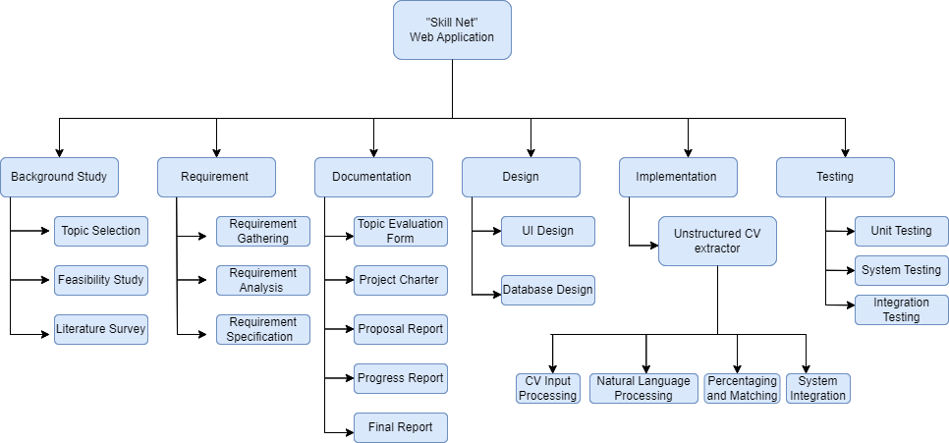
WORK BREAKDOWN CHART
IT21374838 | Silva K.H.L.D | 24-25J-298
‹#›
12/3/2024
‹#›

Slide 73
REFERENCES
[1] I. Davydov, "Development of an Intelligent System for Automatic Generation of Individual Study Plans," [Online]. Accessed: Aug. 4, 2024.
[2] M. Gupta, S. Garg, and P. K. Singh, "A Comprehensive Survey on Machine Learning and Deep Learning Based Methods for Automatic Information Extraction from Resumes," IEEE Access, vol. 9, pp. 84119-84136, 2021, doi: 10.1109/ACCESS.2021.3087913.
[3] A. Kumar, R. Pandey, and A. Tripathi, "Efficient Techniques for Extracting Information from Unstructured Resumes," in Proceedings of the International Conference on Computing, Communication, and Intelligent Systems (ICCCIS), Springer, Singapore, 2021, pp. 581-593, doi: 10.1007/978-981-16-2126-0_54.
[4] M. B. Raut, N. S. Marathe, and S. S. Mantha, "Resume Information Extraction and Matching with Job Descriptions Using Machine Learning Techniques," International Journal of Information Technology and Computer Science (IJITCS), vol. 10, no. 9, pp. 22-30, 2018. Accessed: Aug. 4, 2024.
[5] I. P. Rakhlin, "Information Extraction Method from a Resume (CV)," Science Journal, vol. 12, no. 5, pp. 45-52, 2021. Accessed: Aug. 4, 2024.
IT21374838 | Silva K.H.L.D | 24-25J-298
‹#›
12/3/2024
‹#›

Slide 74


09 COMMERCIALIZATION ASPECTS
Market Potential
Target educational institutions
Target online course providers
Revenue Model
Subscription-based pricing
Licensing fees
Our app offers budget friendly subscriptions
making quality education accessible to all.
User Segmentation
Schools and institutions
Individual learners
Non-profits and Low-income Users
Free or discounted rates
Marketing Strategy
Promote through educational conferences
Advertise on online platforms
Direct outreach to potential clients
‹#›
12/3/2024
‹#›

Slide 75
Thank You
‹#›
12/3/2024
‹#›

